Slide 1
Digital Image Processing
Image Restoration
Noise models and additive noise removal
COMSATS University Islamabad, Lahore Campus Digital Image Processing CSD 331

Slide 2
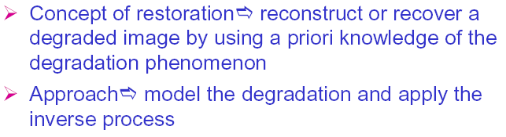
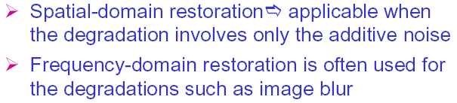
Image Restoration
COMSATS University Islamabad, Lahore Campus Digital Image Processing CSD 331

Slide 3
Image Restoration
What is noise (in the context of image processing) and how can it be modeled?
What are the main types of noise that may affect an image?
What are the possible solutions?
Subjective Vs Objective (Enhancement Vs Restoration)
COMSATS University Islamabad, Lahore Campus Digital Image Processing CSD 331

Slide 4
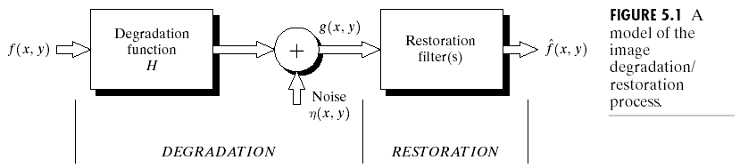
Degradation Model for a Digital Image
COMSATS University Islamabad, Lahore Campus Digital Image Processing CSD 331

Slide 5
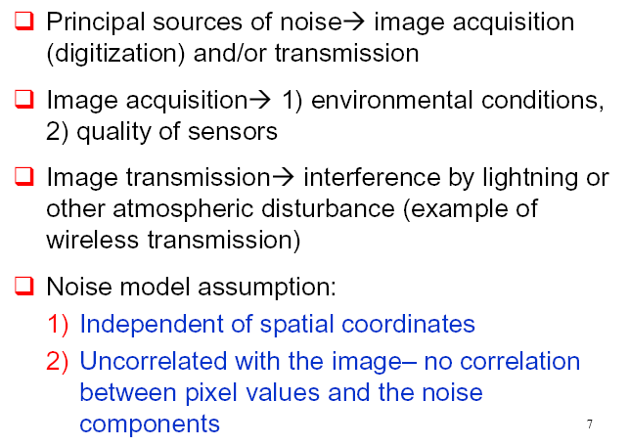
Noise Models
COMSATS University Islamabad, Lahore Campus Digital Image Processing CSD 331

Slide 6
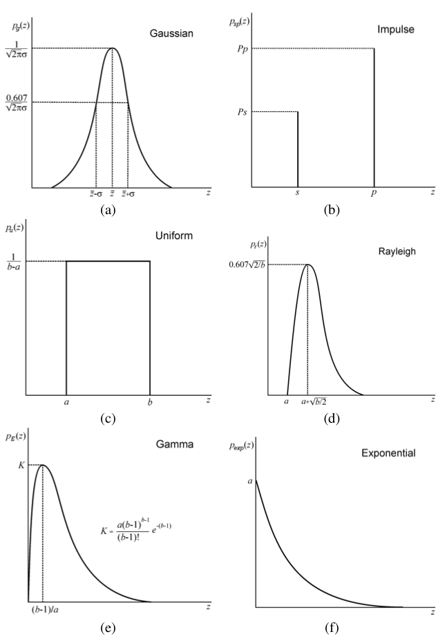
Noise and Noise Models
Gaussian (normal)
Impulse (salt-and-pepper)
Uniform
Rayleigh
Gamma (Erlang)
Exponential
COMSATS University Islamabad, Lahore Campus Digital Image Processing CSD 331

Slide 7
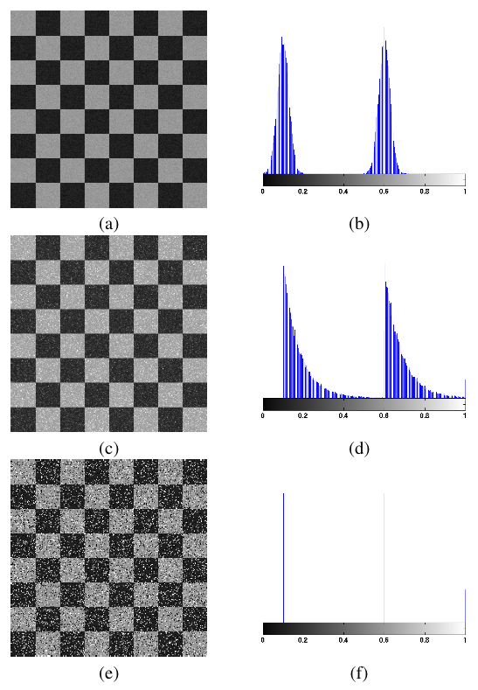
Effect of Noise on Images & Histograms
Gaussian
Exponential
Impulse
(salt-and-pepper)
COMSATS University Islamabad, Lahore Campus Digital Image Processing CSD 331

Slide 8
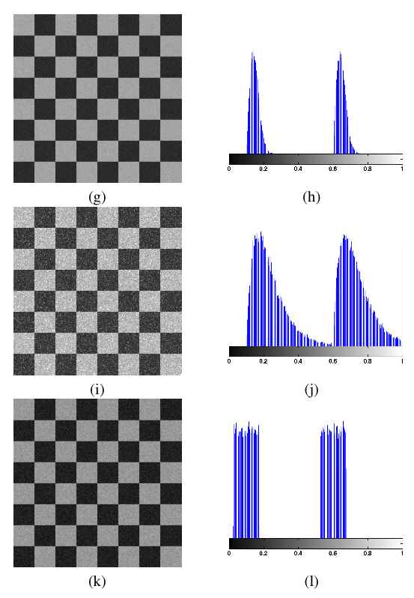
Effect of Noise on Images & Histograms
Rayleigh
Gamma (Erlang)
Uniform
COMSATS University Islamabad, Lahore Campus Digital Image Processing CSD 331

Slide 9
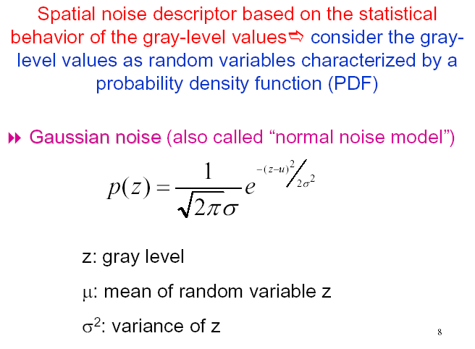
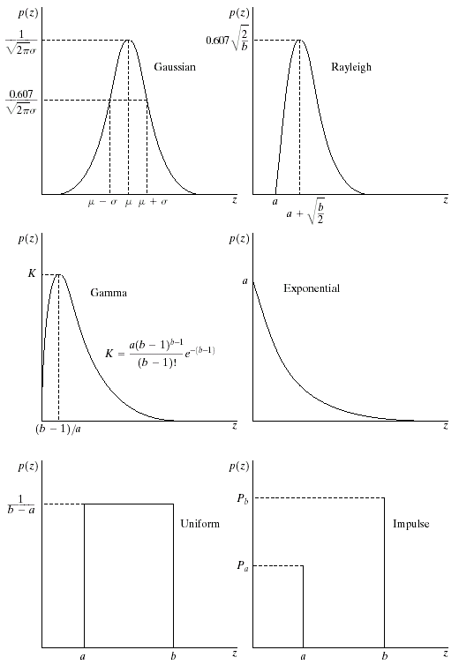
Noise Models: Gaussian Noise
COMSATS University Islamabad, Lahore Campus Digital Image Processing CSD 331

Slide 10
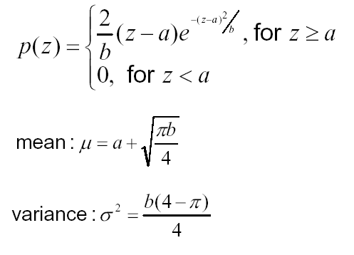

Noise Models: Rayleigh Noise
COMSATS University Islamabad, Lahore Campus Digital Image Processing CSD 331

Slide 11
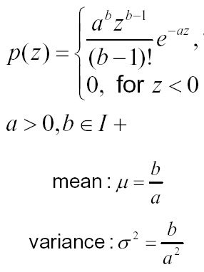

Noise Models: Erlang (Gamma) Noise
COMSATS University Islamabad, Lahore Campus Digital Image Processing CSD 331

Slide 12

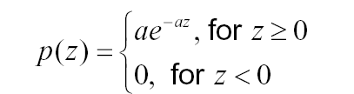

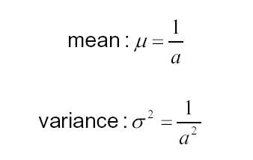
Noise Models: Exponential Noise
Where
COMSATS University Islamabad, Lahore Campus Digital Image Processing CSD 331

Slide 13
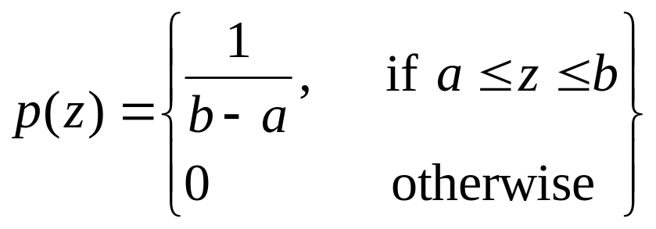
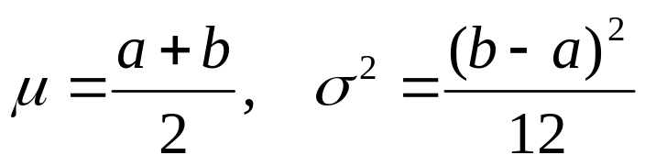
Noise Models: Uniform Noise
The mean and variance are
given by
COMSATS University Islamabad, Lahore Campus Digital Image Processing CSD 331

Slide 14
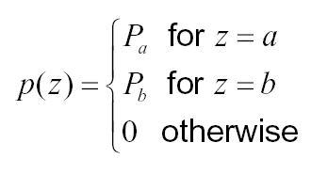
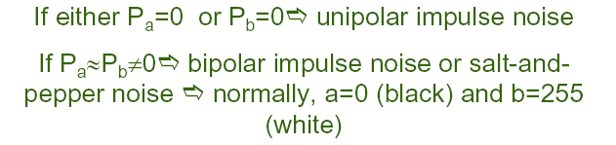
Noise Models: Impulse (Salt and Pepper) Noise
COMSATS University Islamabad, Lahore Campus Digital Image Processing CSD 331

Slide 15


Effect of Noise on Images & Histograms
COMSATS University Islamabad, Lahore Campus Digital Image Processing CSD 331

Slide 16
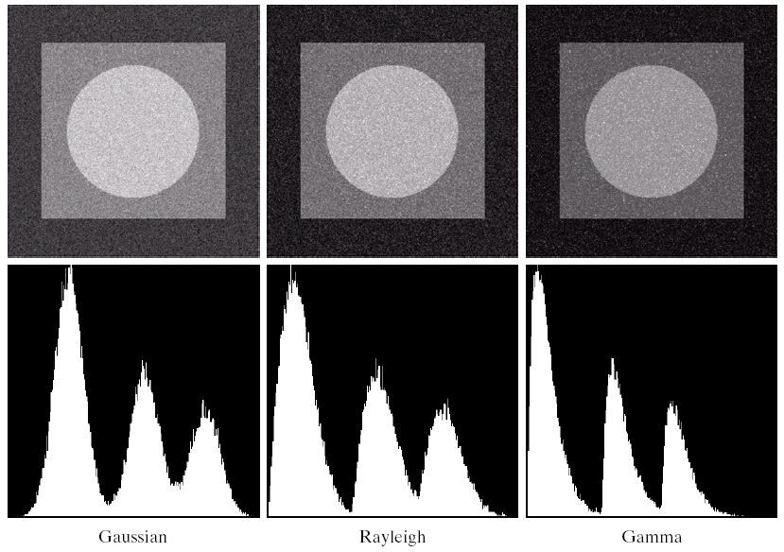
Effect of Noise on Images & Histograms
COMSATS University Islamabad, Lahore Campus Digital Image Processing CSD 331

Slide 17
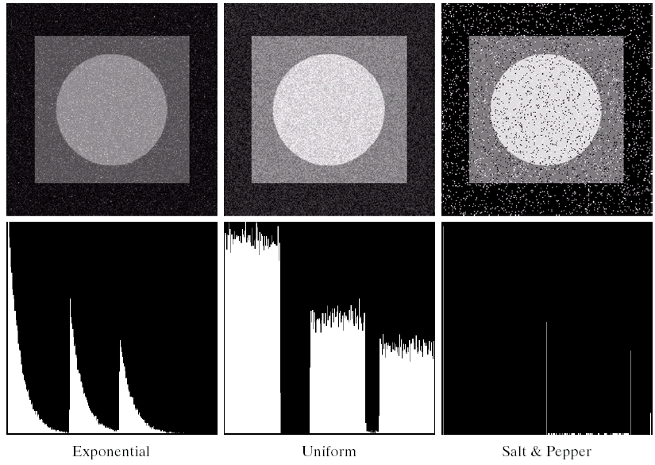
Effect of Noise on Images & Histograms
COMSATS University Islamabad, Lahore Campus Digital Image Processing CSD 331

Slide 18
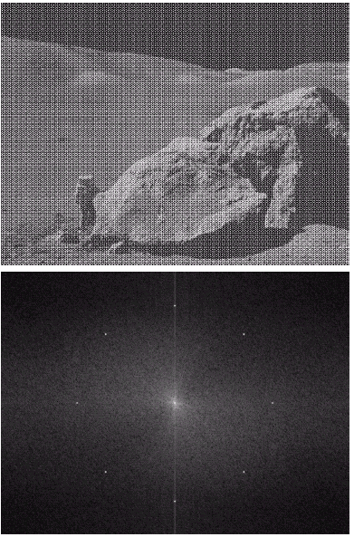
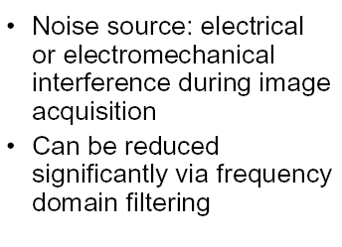
Periodic Noise (Example)
Spatially Dependent Case
COMSATS University Islamabad, Lahore Campus Digital Image Processing CSD 331

Slide 19
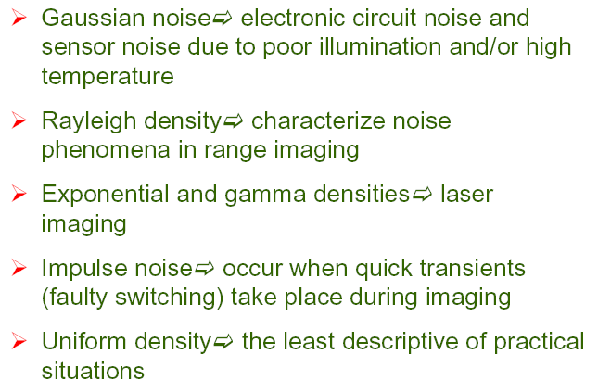
Applicability of various noise models
COMSATS University Islamabad, Lahore Campus Digital Image Processing CSD 331

